Slide 1
S.A. ENGINEERING COLLEGE- CHENNAI-77
(Autonomous- Institute Level Research Centre, Affiliated to Anna University)
DEPARTMENT OF ARTIFICIAL INTELLIGENCE & DATA SCIENCE
AD1703A - Project Phase-1
ZEROTH REVIEW
TITLE : AERIS
An Explainable Reasoning and Investigation System for Intelligent Aerospace Maintenance
BATCH NUMBER : 13
TEAM MEMBERS | SUPERVISOR
111923AI01003 – ABIRAMI M 111923AI01022 – DEVISHRI S | Mrs. NATHIYA M, Assistant Professor, Department of AI&DS

Slide 2
Agenda
Introduction
Base Paper [ IEEE Transactions, ACM, springer, etc.. Note: base paper should not be conference or survey paper]
Abstract
Scope and Motivation
Literature Survey [ Authors, year, journal/conference name, findings, limitations in table - min 10 papers]
Objectives / Problem Statement [ Minimum 3 objectives]
SDG Mapping and description
Proposed Work
  Architecture Diagram/Flow Diagram/Block Diagram
  Modules
  Module Description
Software & Hardware Requirements
References [ should include 10 references and follow MLA/ IEEE format ]

Slide 3
Introduction
Aircraft component failures pose significant challenges to aviation safety, operational reliability, and maintenance costs. AERIS is an AI-powered Evidence-Driven Investigation Platform that goes beyond conventional predictive maintenance by identifying what is likely to fail, when it may fail, and why it may happen. By combining aircraft sensor data, maintenance records, historical failure cases, causal knowledge, and technical documents, the system investigates potential root causes, fuses supporting and conflicting evidence, and generates explainable investigation reports with actionable maintenance recommendations.

Slide 4
Base Paper
TITLE : Fault inference diagnosis based on causal network and large language model-enhanced knowledge graph network
YEAR : 2026
JOURNAL NAME: Chinese Journal of Mechanical Engineering
ARTICLE TYPE : Original Research Article
The base paper proposes a CN-LLM-KGN framework that integrates Causal Networks (CN), Knowledge Graphs (KG), and Large Language Models (LLMs) to perform fault diagnosis and root cause localization in rotating machinery. It improves explainability by identifying causal relationships behind equipment failures and achieved 81.12% root cause localization accuracy.

Slide 5
Abstract
Aircraft component failures pose significant challenges to aviation safety, operational reliability, and maintenance costs. The proposed system investigates potential failures by analyzing sensor data, maintenance records, historical failure cases, causal relationships, and technical documents. A time-series model identifies abnormal behavior and potential degradation, while causal reasoning and knowledge graphs explore possible failure causes. Dempster-Shafer evidence fusion combines supporting and conflicting evidence to generate reliable root-cause hypotheses. Finally, RAG and LLM-based report generation provide explainable findings and actionable maintenance recommendations for maintenance engineers.

Slide 6
Scope and Motivation
Scope: AERIS focuses on AI-driven investigation of aircraft component failures, covering failure detection, root-cause investigation, evidence analysis, and maintenance decision support. The system is intended for use by aircraft maintenance engineers to assist in failure investigation and assessment.
Motivation: Existing predictive maintenance approaches mainly focus on detecting or predicting failures, leaving engineers to investigate the reasons separately. AERIS is motivated by the need for a transparent system that can connect different sources of evidence and support engineers in understanding potential failure causes and making informed maintenance decisions.

Slide 7
Literature Survey
S no | Title of the Paper | Year | Journal/ Conference | Inferences/Findings | Limitations
1 | Fault Inference Diagnosis Based on Causal Network and Large Language Model-Enhanced Knowledge Graph Network | 2026 | Chinese Journal of Mechanical Engineering | Improved root cause localization using CN + LLM + Knowledge Graph with explainable reasoning. | Limited to rotating machinery; not designed for aerospace systems.
2 | Aircraft Engine Root Cause Analysis (Nature Paper) | 2026 | Scientific Reports | Improved aircraft fault diagnosis using graph reasoning. | No LLM or RAG integration.
3 | DiagLLM: Multimodal Reasoning with Large Language Model for Explainable Bearing Fault Diagnosis | 2025 | Science China Information Sciences | Uses LLM for explainable fault diagnosis through multimodal reasoning. | Focused only on bearing faults; lacks multi-source evidence fusion.
4 | Causal Inference-Enabled Graph Neural Networks for Generalized Fault Diagnosis in Industrial IoT Systems | 2025 | Information Sciences | Applies causal inference with GNNs for generalized industrial fault diagnosis. | Industrial IoT focused; no knowledge retrieval or report generation.

Slide 8
Literature Survey
S no | Title of the Paper | Year | Journal/ Conference | Inferences/Findings | Limitations
6 | Large Language Model Assisted Fine-Grained Knowledge Graph Construction for Robotic Fault Diagnosis | 2025 | Advanced Engineering Informatics | Uses LLMs to enhance Knowledge Graph construction for diagnosis. | Focused on KG construction rather than complete investigation.
7 | Causal Discovery for Rolling Bearing Fault Under Missing Data: From the Perspective of Causal Effect and Information Flow | 2025 | IEEE Transactions on Instrumentation and Measurement | Discovers causal relationships from incomplete sensor data. | Limited to causal discovery; lacks recommendation and reporting.
8 | An Interpretable Integration Fusion Time-Frequency Prototype Contrastive Learning for Machine Fault Diagnosis with Limited Labeled Samples | 2025 | Information Fusion | Improves diagnosis accuracy using interpretable time-frequency learning. | Focuses on classification; no root cause investigation.
9 | A Trustworthy Lightweight Multi-Expert Wavelet Transformer for Rotating Machinery Fault Diagnosis | 2025 | Mechanical Systems and Signal Processing | Uses lightweight Transformer for accurate rotating machinery fault diagnosis. | Concentrates on prediction only; lacks explainable investigation and evidence fusion.

Slide 9
Objectives
The main objective of AERIS is to develop an AI-powered Aircraft Investigation Platform that predicts potential component failures and explains their root causes using evidence-driven AI. The system provides explainable insights and maintenance recommendations to support better decision-making.
Objective 1 : To detect abnormal aircraft component behavior and assess potential degradation.
Objective 2 : To investigate possible failure causes by analysing and fusing diverse sources of evidence.
Objective 3 : To deliver clear investigation findings and maintenance actions for engineering decision-making.

Slide 10
Problem Statement
Aircraft component failures can compromise aviation safety, increase maintenance costs, and cause unexpected operational delays. Existing systems mainly predict failures or detect anomalies but often fail to explain why a failure is occurring or provide evidence-backed maintenance recommendations. AERIS addresses this by delivering explainable, evidence-driven failure investigation with root-cause analysis and intelligent maintenance recommendations for engineers.

Slide 11
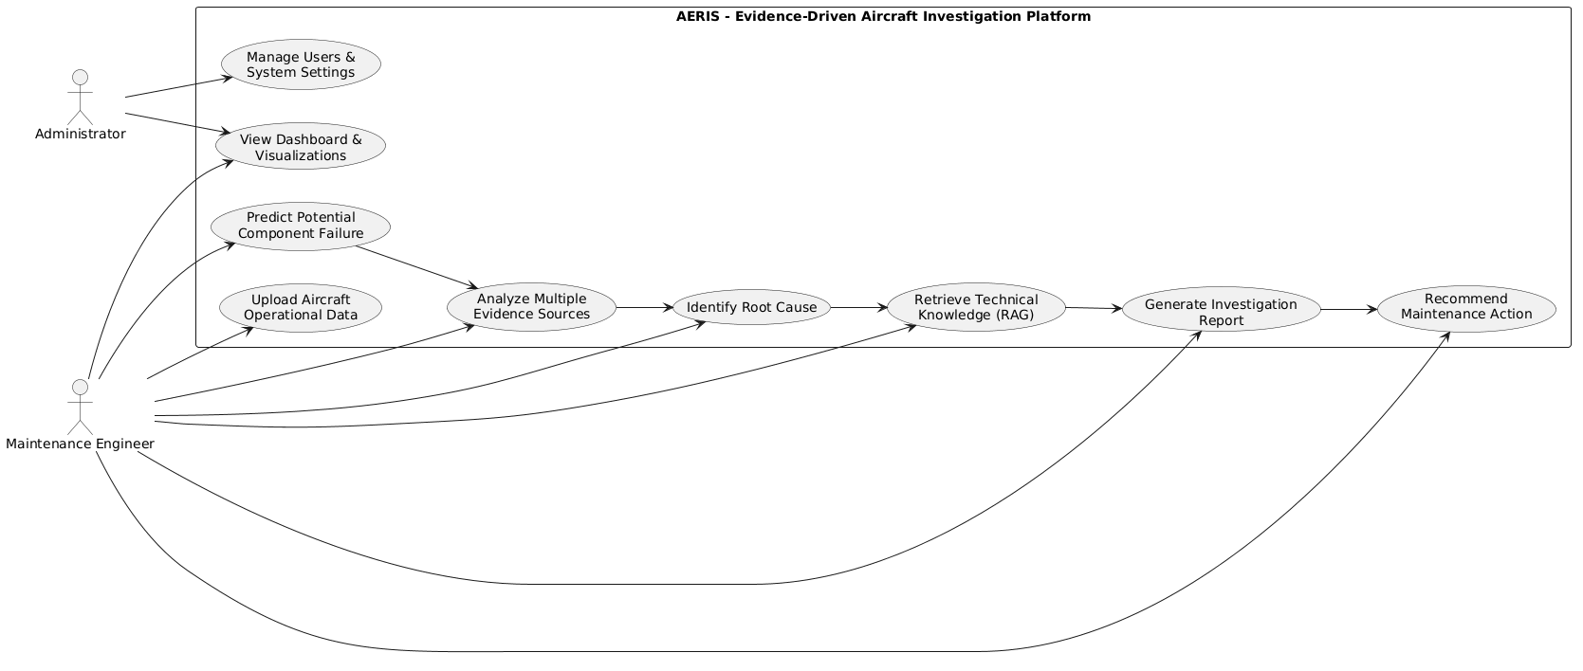
Proposed Work-Block Diagram

Slide 12
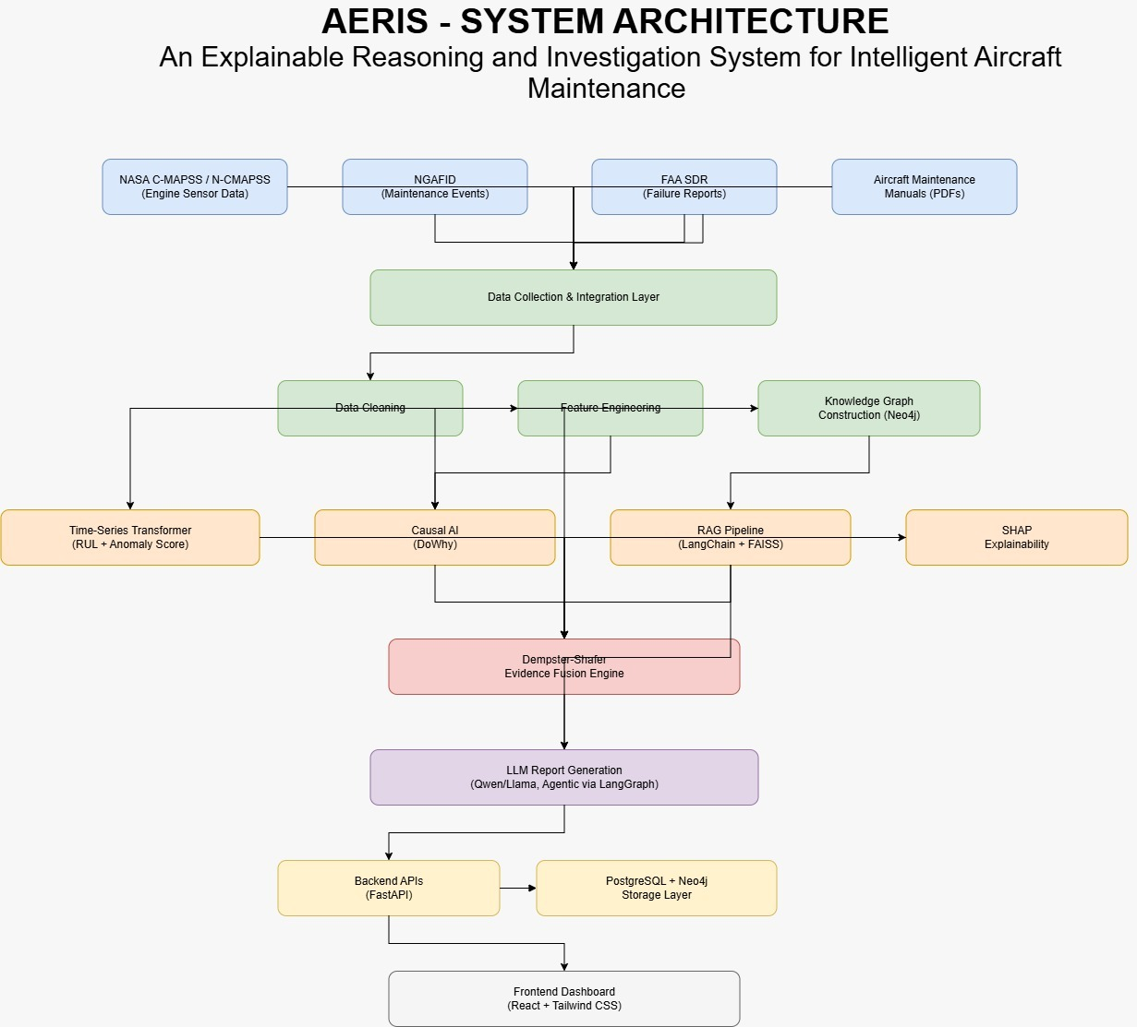
Architecture Diagram

Slide 13
Modules
Module 1 – Data Collection & Preprocessing
Module 2 – Failure Prediction
Module 3 – Investigation & Root Cause Analysis
Module 4 – Report Generation & Maintenance Recommendation

Slide 14
Proposed-Module Description
Module 1 – Data Collection & Preprocessing
Purpose: Collect and prepare aircraft operational data.
How it Works: Integrates sensor data, maintenance records, flight logs, and weather information, then cleans and transforms them into structured features.
Outcome: A high-quality dataset ready for AI analysis.
Module 2 – Failure Prediction
Purpose: Predict potential aircraft component failures.
How it Works: A Time-Series AI model analyzes historical patterns and detects anomalies to estimate failure risk.
Outcome: Early warnings with predicted failure probability and confidence score.

Slide 15
Proposed-Module Description
Module 3 – Evidence-Driven Investigation
Purpose: Identify the root cause behind predicted failures.
How it Works: The Investigation Engine combines maintenance history, operational context, and causal relationships to reconstruct the chain of evidence.
Outcome: Explainable root cause with supporting evidence and confidence level.
Module 4 – Recommendation & Report Generation
Purpose: Assist engineers in making maintenance decisions.
How it Works: RAG and an LLM retrieve relevant technical knowledge and generate evidence-based maintenance recommendations.
Outcome: A clear investigation report with actionable maintenance suggestions.

Slide 16
Software Requirements
Software Requirements
Operating System: Windows 10/11 or Ubuntu
Programming Language: Python 3.11+
IDE: Visual Studio Code / Jupyter Notebook
Database: PostgreSQL
Libraries & Frameworks:
Pandas, NumPy – Data Processing
Scikit-learn – Machine Learning
PyTorch – Time-Series Transformer
DoWhy – Causal Analysis
Neo4j – Knowledge Graph
LangChain – RAG Pipeline
FAISS – Vector Search
Hugging Face Transformers – LLM Integration
SHAP – Model Explainability
Matplotlib, Seaborn – Visualization
Backend: FastAPI
Frontend: React, Tailwind CSS

Slide 17
References
[1] Z. Guo, Z. Liu, E. Estupiñan, and D. Cabrera, “Fault Inference Diagnosis Based on Causal Network and Large Language Model-Enhanced Knowledge Graph Network,” Chinese Journal of Mechanical Engineering, vol. 39, Art. no. 100162, 2026.
[2] J. Wang, T. Li, Y. Yang, et al., “DiagLLM: Multimodal Reasoning with Large Language Model for Explainable Bearing Fault Diagnosis,” Science China Information Sciences, vol. 68, no. 1, 2025.
[3] S. Zheng, K. Pan, J. Liu, et al., “Empirical Study on Fine-Tuning Pre-trained Large Language Models for Fault Diagnosis of Complex Systems,” Reliability Engineering & System Safety, vol. 252, Art. no. 110382, 2024.
[4] Z. Zhang, Q. Li, S. Liu, et al., “Causal Inference-Enabled Graph Neural Networks for Generalized Fault Diagnosis in Industrial IoT Systems,” Information Sciences, vol. 694, Art. no. 121719, 2025.
[5] Z. Mao, H. Wang, B. Jiang, et al., “Graph Convolutional Neural Network for Intelligent Fault Diagnosis of Machines via Knowledge Graph,” IEEE Transactions on Industrial Informatics, vol. 20, no. 5, pp. 7862–7870, 2024.

Slide 18
References
[6] X. Liao, C. Chen, Z. Wang, et al., “Large Language Model Assisted Fine-Grained Knowledge Graph Construction for Robotic Fault Diagnosis,” Advanced Engineering Informatics, vol. 65, Art. no. 103134, 2025.
[7] X. Ding, H. Wu, J. Wang, et al., “Causal Discovery for Rolling Bearing Fault Under Missing Data: From the Perspective of Causal Effect and Information Flow,” IEEE Transactions on Instrumentation and Measurement, vol. 74, pp. 1–17, 2025.
[8] Y. Dong, H. Jiang, X. Wang, et al., “An Interpretable Integration Fusion Time-Frequency Prototype Contrastive Learning for Machine Fault Diagnosis with Limited Labeled Samples,” Information Fusion, vol. 124, Art. no. 103340, 2025.
[9] D. Song, F. Zhang, M. Lu, et al., “DTransE: Distributed Translating Embedding for Knowledge Graph,” IEEE Transactions on Parallel and Distributed Systems, vol. 32, no. 10, pp. 2509–2523, 2021.
[10]Y. Dong, H. Jiang, M. Mu, et al., “A Trustworthy Lightweight Multi-Expert Wavelet Transformer for Rotating Machinery Fault Diagnosis,” Mechanical Systems and Signal Processing, vol. 235, Art. no. 112945, 2025.

Slide 19
S.A. ENGINEERING COLLEGE- CHENNAI-77
(Autonomous- Institute Level Research Centre, Affiliated to Anna University)
DEPARTMENT OF ARTIFICIAL INTELLIGENCE & DATA SCIENCE
AD1703A - Project Phase-1
FIRST REVIEW
TITLE : AERIS
An Explainable Reasoning and Investigation System for Intelligent Aerospace Maintenance
BATCH NUMBER : 13
TEAM MEMBERS | SUPERVISOR
111923AI01003 – ABIRAMI M 111923AI01022 – DEVISHRI S | Mrs. NATHIYA M, Assistant Professor, Department of AI&DS

Slide 20
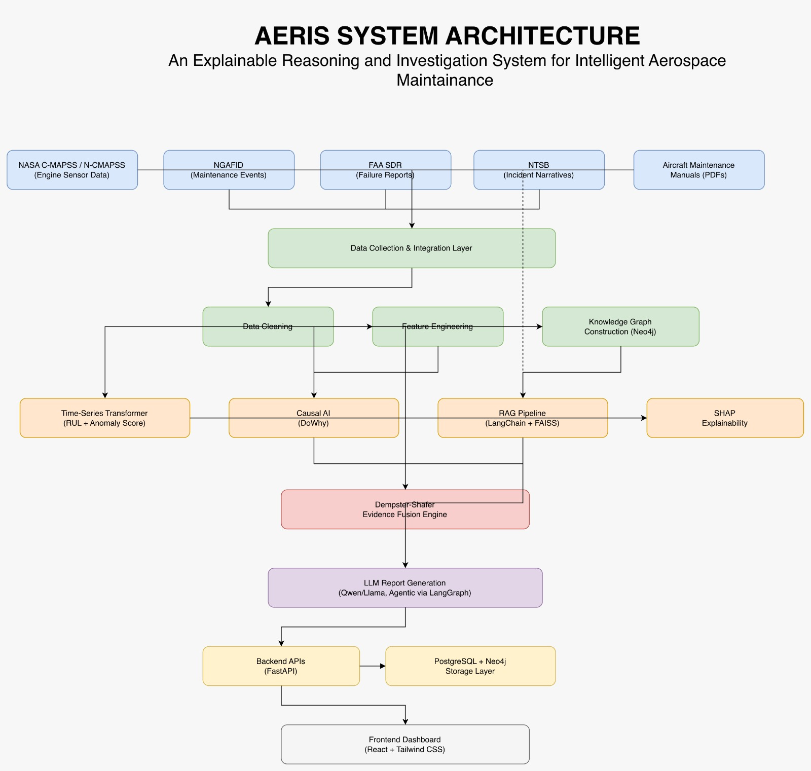
Architecture Diagram

Slide 21
SYSTEM ARCHITECTURE DESCRIPTION
1. Data & Processing Layer
Data Sources: NASA C-MAPSS/N-CMAPSS, NGAFID, FAA SDR, Aircraft Maintenance Manuals
Data Integration: Collects and integrates information from multiple sources
Data Processing: Performs data cleaning and feature engineering
2. AI, Reasoning & Application Layer
Failure Prediction: Time-Series Transformer performs RUL estimation and anomaly scoring
Causal Analysis: DoWhy identifies causal relationships behind potential failures
Knowledge Graph: Neo4j represents relationships between components, events and failures
Knowledge Retrieval: LangChain + FAISS retrieves relevant technical information
Explainability: SHAP provides feature-level explanations
Evidence Fusion: Dempster-Shafer combines evidence from multiple sources
Report Generation: Qwen/Llama + LangGraph generates investigation reports
Application: FastAPI connects the AI system with PostgreSQL/Neo4j and the React + Tailwind CSS dashboard

Slide 22
SYSTEM ARCHITECTURE DESCRIPTION
3. AI Prediction & Investigation Layer
Health Monitoring: Analyzes aircraft operating conditions and component health trends
Anomaly Detection: Identifies deviations from normal aircraft behavior
RUL Estimation: Predicts the remaining useful life of critical components
Root Cause Analysis: Traces the probable cause of an emerging failure
Causal Reasoning: Links observed symptoms with potential underlying causes
Historical Comparison: Compares current failure patterns with previous similar cases
4. Evidence & Decision Layer
Evidence Collection: Gathers supporting information from sensors, maintenance and operational data
Evidence Fusion: Combines evidence to strengthen the root-cause conclusion
Confidence Assessment: Determines the confidence of the investigation result
Maintenance Recommendation: Suggests appropriate maintenance actions
Risk Assessment: Highlights potential consequences if the issue is not addressed
Investigation Report: Presents the findings, evidence and recommended action in an engineer-readable format.

Slide 23
SYSTEM ARCHITECTURE DESCRIPTION
5. Backend & Storage Layer
API Management: FastAPI manages communication between the AI components and application
Structured Storage: PostgreSQL stores aircraft, sensor, maintenance and prediction data
Graph Storage: Neo4j stores component, event and failure relationships
Model Integration: Connects prediction, reasoning, evidence and LLM services
Data Retrieval: Provides required information to the investigation and reporting components
6. Engineer Dashboard Layer
Health Overview: Displays aircraft and component health status
Failure Prediction: Shows predicted failures, anomaly scores and RUL
Root Cause: Displays the identified cause and causal relationships
Evidence: Presents supporting evidence and confidence scores
Recommendations: Shows suggested maintenance actions
Investigation Report: Provides the generated report for engineer review

Slide 24
SYSTEM ARCHITECTURE DESCRIPTION
7. System Output Layer
Failure Alert: Highlights detected anomalies and potential component failures
Root Cause Explanation: Presents the most probable cause with supporting relationships
Evidence Summary: Displays the key evidence contributing to the conclusion
Confidence Score: Indicates the confidence of the investigation result
Maintenance Action: Provides the recommended inspection, repair or replacement action
Investigation Report: Generates a consolidated report for maintenance engineers
8. Continuous Learning & Improvement Layer
Flight Updates: Incorporates data from newly completed flights
Model Monitoring: Tracks prediction and anomaly-detection performance
Knowledge Updates: Updates the Knowledge Graph with new aircraft events and relationships
Feedback Integration: Uses engineer feedback to improve investigation results
Continuous Improvement: Refines prediction, reasoning and recommendation performance over time

Slide 25
DATASET USED
Dataset | Collected On / Domain | Source | Used For
NASA C-MAPSS / N-CMAPSS | Simulated aircraft turbofan engine sensor readings (temperature, pressure, speed, vibration across multiple flight cycles) | NASA Prognostics Center of Excellence | Training the Time-Series Transformer to predict Remaining Useful Life (RUL) and detect anomalies
NGAFID (National General Aviation Flight Information Database | Real flight data and maintenance event logs from general aviation aircraft | NGAFID (University of North Dakota / FAA-supported) | Building maintenance history context and correlating flight patterns with failure events
FAA SDR (Service Difficulty Reports) | Real-world aircraft failure and malfunction reports submitted by operators/mechanics | Federal Aviation Administration (FAA) | Root cause investigation and validating real failure patterns against predictions
Aircraft Maintenance Manuals (PDFs) | Technical maintenance procedures, component specifications, and troubleshooting guides | e.g., Aerospool WT9 Dynamic AMM (AS-AMM-01-000, aerospool.sk) | RAG pipeline (LangChain + FAISS) — retrieves relevant manual sections/procedures to ground the LLM's investigation report in official documentation

Slide 26
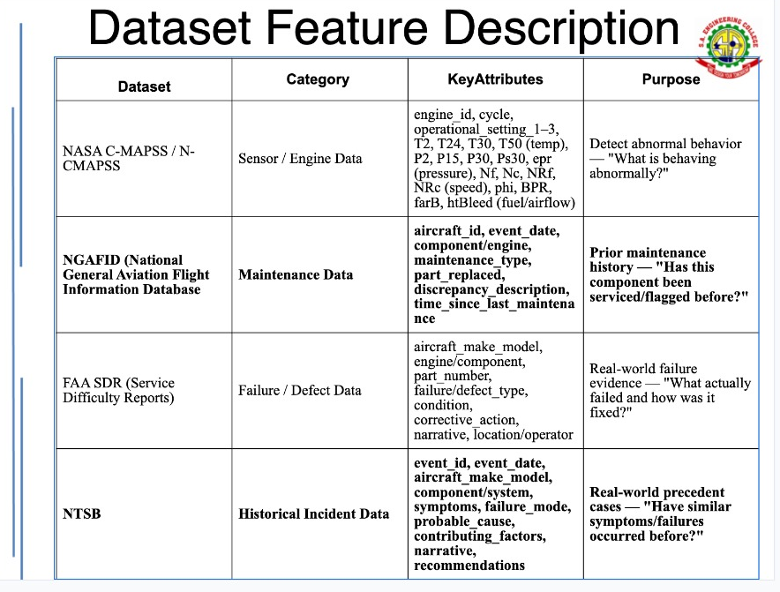

Slide 27
Modules
MODULE 1 — DATA ACQUISITION & INTEGRATION
MODULE 2 — AIRCRAFT HEALTH & FAILURE PREDICTION
MODULE 3 — EVIDENCE-DRIVEN INVESTIGATION
MODULE 4 — EVIDENCE FUSION & EXPLAINABILITY
MODULE 5 — KNOWLEDGE-GUIDED RECOMMENDATION & REPORTING
MODULE 6 — ENGINEER INTERACTION & VISUALIZATION

Slide 28
Proposed-Module Description
MODULE 1 — DATA ACQUISITION & INTEGRATION
Purpose: Collect and unify aircraft information from multiple sources.
Aircraft sensor and operational data
Maintenance and failure records
Historical flight information
Technical and maintenance documents
Output: A unified aircraft data repository for analysis.
MODULE 2 — AIRCRAFT HEALTH & FAILURE PREDICTION
Purpose: Detect degradation and predict potential component failures.
Analyze time-series sensor patterns
Detect abnormal aircraft behaviour
Estimate component failure probability
Predict Remaining Useful Life (RUL)
Output: Predicted failure, risk level and estimated time to failure.

Slide 29
Proposed-Module Description
MODULE 3 — EVIDENCE-DRIVEN INVESTIGATION
Purpose: Identify the likely root cause behind a predicted failure.
Analyze sensor and operational patterns
Examine maintenance history
Connect related components and events
Trace causal relationships
Compare with historical failure cases
Output: Likely root cause with supporting evidence.
MODULE 4 — EVIDENCE FUSION & EXPLAINABILITY
Purpose: Combine evidence from different sources and make the prediction understandable.
Fuse multi-source evidence
Rank important contributing factors
Explain model predictions using SHAP
Assign confidence to the investigation result
Output: Evidence-backed root cause with confidence and feature contributions.

Slide 30
Proposed-Module Description
MODULE 5 — KNOWLEDGE-GUIDED RECOMMENDATION & REPORTING
Purpose: Convert investigation results into actionable maintenance guidance.
Retrieve relevant maintenance information using RAG
Generate evidence-based explanations using LLM
Suggest appropriate maintenance actions
Generate an investigation report
Provide supporting references from technical documents
Output: Explainable maintenance recommendation and investigation report.
MODULE 6 — ENGINEER INTERACTION & VISUALIZATION
Purpose: Provide engineers with a clear interface to monitor aircraft health and investigate potential failures.
View aircraft and component health status
Display failure predictions and RUL
Visualize root causes and supporting evidence
View maintenance recommendations
Access generated investigation reports
Output: An interactive dashboard for aircraft investigation and maintenance decision-making.

Slide 31
S.A. ENGINEERING COLLEGE- CHENNAI-77
(Autonomous- Institute Level Research Centre, Affiliated to Anna University)
DEPARTMENT OF ARTIFICIAL INTELLIGENCE & DATA SCIENCE
AD1703A - Project Phase-1
SECOND REVIEW
TITLE : AERIS
An Explainable Reasoning and Investigation System for Intelligent Aerospace Maintenance
BATCH NUMBER : 13
TEAM MEMBERS | SUPERVISOR
111923AI01003 – ABIRAMI M 111923AI01022 – DEVISHRI S | Mrs. NATHIYA M, Assistant Professor, Department of AI&DS

Slide 32
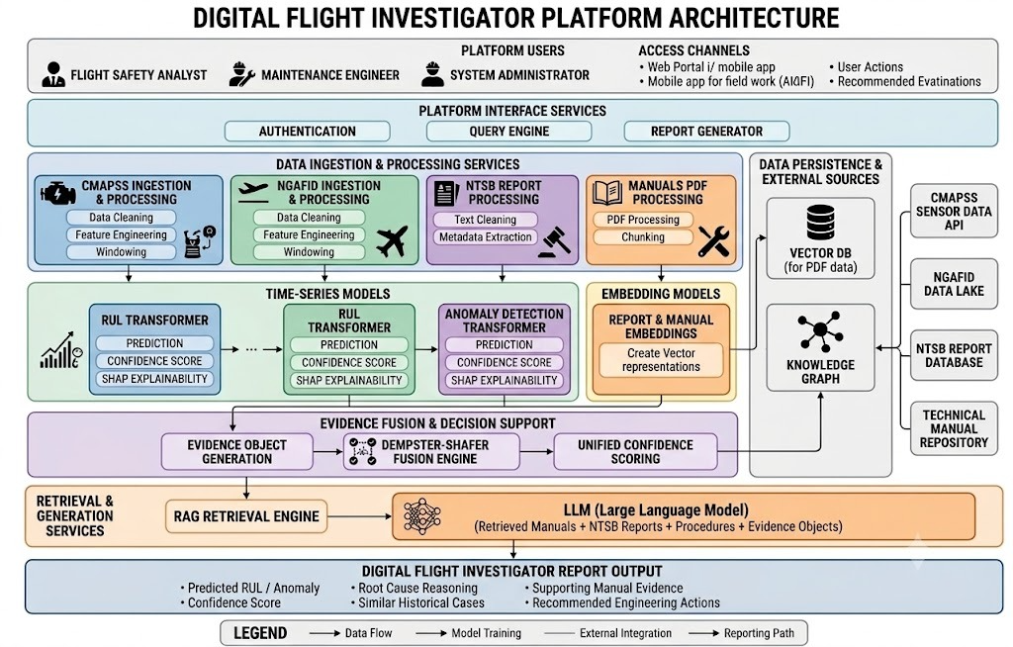
OVERALL ARCHITECTURE

Slide 33
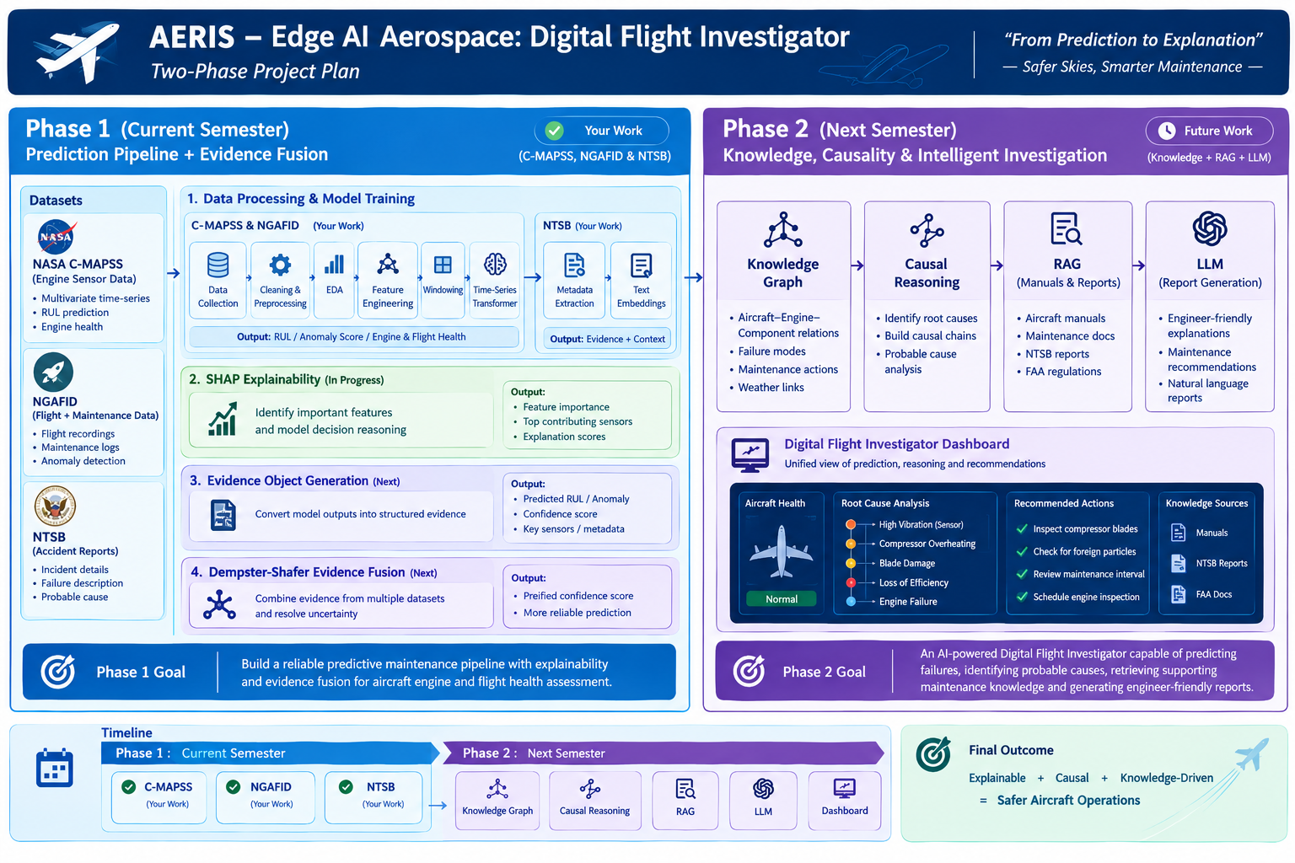
PROJECT PHASES

Slide 34
CMAPSS – DATASET
DATASET OVERVIEW:
Dataset: NASA C-MAPSS (FD001 subset)
Simulated turbofan jet engine degradation data
Multiple engines, each run until failure across several operational cycles
Multivariate time-series sensor readings recorded per cycle
Goal: Predict Remaining Useful Life (RUL) of each engine
Forms the numeric/sensor-based prediction component of AERIS
Completed Tasks
Dataset Collection (NASA C-MAPSS FD001)
Exploratory Data Analysis (EDA)
Data Cleaning & Preprocessing
Baseline – LSTM
Feature Engineering
Time-Series Transformer Model
Current Output
Predicted Remaining Useful Life (RUL)
Prediction Error (MAE / RMSE)
Model Confidence
Engine Health Prediction

Slide 35
CMAPSS Work Completed
Dataset: NASA C-MAPSS (FD001) – turbofan engine sensor data
Preprocessing:
  Cleaned dataset: 20,631 rows, 17 real features (2 operational settings + 15 sensors)
  RUL (Remaining Useful Life) computed and capped at 125 cycles (standard practice)
  Engine-wise train/test split (80/20) — prevents data leakage between cycles of the same engine
  MinMax scaling fit only on training engine, then applied to test set.
  Sliding window sequences (window size = 30) with padding + attention masks.
  Output saved as structured .npz file for model training

Slide 36
CMAPSS – Baseline & LSTM Results
Linear Regression used as baseline model
  MAE: 13.025 | RMSE: 15.761
LSTM model (2-layer, hidden size = 64)
  Target-scaled outputs, gradient clipping applied
  MAE: 8.818 | RMSE: 13.081
LSTM shows clear improvement over baseline Confirms sequence models capture degradation patterns better than static regression

Slide 37
Transformer Model for RUL Prediction
Purpose of Transformer Model
Predict the Remaining Useful Life (RUL) of aircraft engines from multivariate sensor time-series data.
Learn degradation patterns and estimate engine health before failure.
How it Works
Takes 30-cycle sensor windows as input.
Uses Multi-Head Self-Attention to identify important sensor relationships.
Positional Encoding preserves the sequence order of engine cycles.
Feed Forward Networks generate the final RUL prediction.
Role in AERIS
Generates the health status and RUL prediction for each engine.
Produces the primary predictive evidence used by the AERIS framework.
Sends prediction results to the Evidence Fusion (Dempster–Shafer) module, where they are combined with maintenance records, accident reports, and knowledge graph reasoning.

Slide 38
CMAPSS – Transformer Model Development
First attempt: naive Transformer (D_MODEL=64, dropout=0.1)
  Result: overfit, underperformed LSTM
  MAE: 9.066 | RMSE: 13.924
Root cause: model too large/complex for dataset size, no proper validation control
Fix applied:
  Reduced model size (D_MODEL=32, N_HEADS=4, N_LAYERS=2)
  Increased dropout (0.3) + weight decay (1e-4)
  Added engine-window-level train/validation split
  Early stopping (patience = 8) + ReduceLROnPlateau scheduler

Slide 39
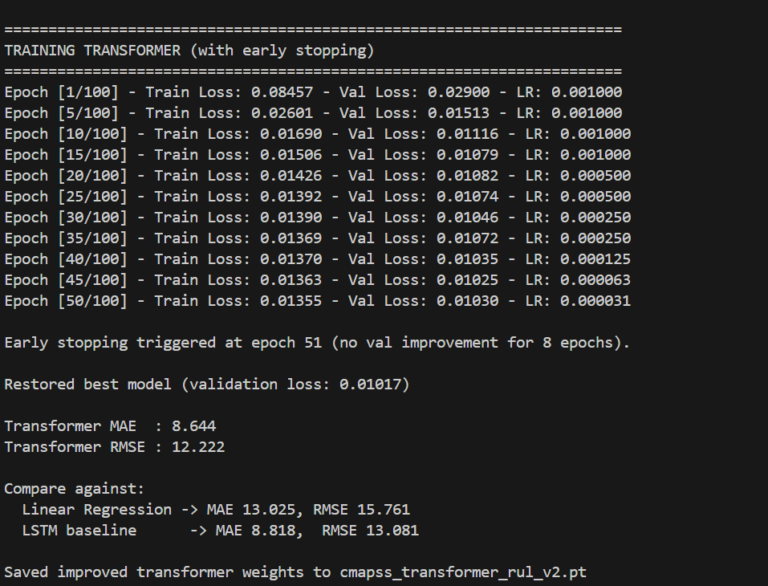
CMAPSS – Final Transformer Results
Final regularized Transformer outperforms both baseline and LSTM
  MAE: 8.644 | RMSE: 12.222
Best-performing model selected for CMAPSS RUL prediction
Model saved as cmapss_transformer_rul_v2.pt
Ready for next steps: SHAP explainability + evidence object packaging for Dempster-Shafer fusion

Slide 40
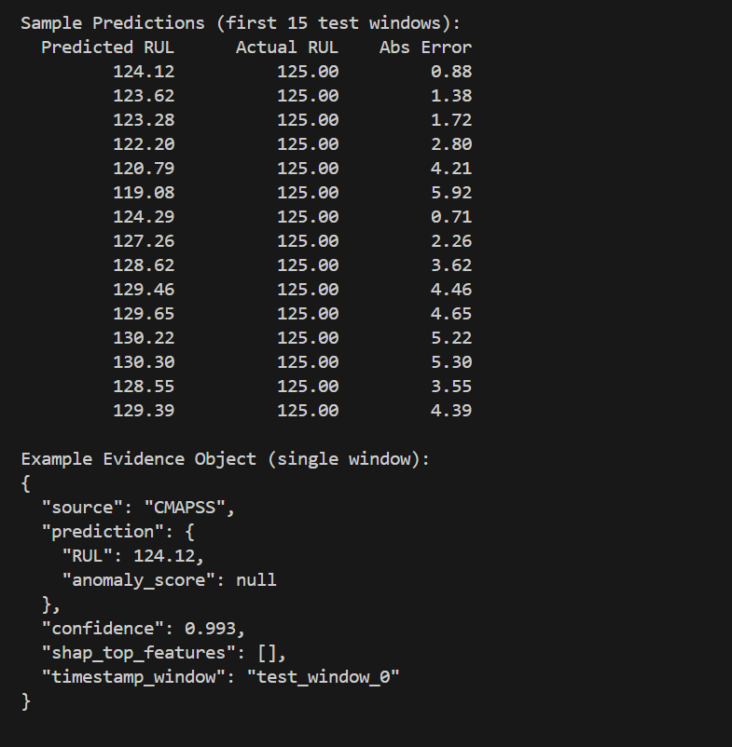
Output Continuation….

Slide 41
UPCOMING IMPLEMENTATION
1.SHAP Explainability
Identify important engine sensors influencing prediction
Explain model decisions
Generate feature importance scores
2. Evidence Object Generation
Convert model outputs into structured evidence containing:
Predicted RUL
Confidence Score
Important Sensors
Timestamp
3. Dempster-Shafer Theory
Combine evidence from multiple datasets
Resolve uncertainty
Produce a unified confidence score
Improve reliability of maintenance decisions
Phase 1 Expected Output
Evidence-Based Engine Health Assessment

Slide 42
NTSB Dataset
DATASET OVERVIEW
Dataset: NTSB Aviation Accident & Incident Final Reports (2016–2023)
Source: Zenodo repository
Replaces originally planned FAA SDR dataset
Key fields available:
  ProbableCause
  Findings
  Full report text (rep_text)
  Aircraft details
  Weather context at time of incident
Adds root-cause narrative data needed for AERIS's explainability goals
Why NTSB Was Chosen
Title: NTSB – Dataset Selection Rationale
Bullets:
FAA SDR dropped: too many missing values in critical fields, no root-cause narrative text
Kaggle "Civil Aviation Accidents" (ASN) dataset considered and rejected:
  Only 9 shallow columns (date, type, registration, operator, fatalities, location, country, category, year)
  Sufficient only for basic statistics, not root-cause modeling
NTSB selected for its rich narrative text (ProbableCause, Findings, rep_text)
Directly supports later Causal AI and RAG modules in AERIS

Slide 43
NTSB – Data Processing & Metadata Generation
Resolved CSV parsing issues; data now loads cleanly for processing
Cleaned and preprocessed accident reports:
  Handled missing values
  Removed unnecessary/redundant fields
Extracted structured metadata from reports:
  Aircraft details
  Weather conditions
  Flight phase
  Location
  Injuries
  Probable cause
Generated metadata files to support downstream embedding & retrieval (RAG pipeline)

Slide 44
NTSB – Next Steps
Generate text embeddings from cleaned report text (rep_text, ProbableCause, Findings)
Build retrieval pipeline (FAISS) using extracted metadata for filtering/context
Design NLP-based modeling approach (classification/retrieval) for root-cause signals
WHAT WE DID
Cleaned and preprocessed accident reports by handling missing values and removing unnecessary fields.
Extracted structured metadata (aircraft, weather, flight phase, location, injuries, probable cause).
Generated metadata files for downstream embedding and retrieval.
ROLE IN AERIS
Provides maintenance knowledge and failure context unavailable in sensor data.
Supports Knowledge Graph, RAG, and LLM-based reasoning for explainable fault investigation.
Contributes evidence to the Dempster–Shafer Fusion module for final decision making.

Slide 45
UPCOMING IMPLEMENTATION
1. Evidence Object Generation
Convert processed NTSB information into standardized evidence objects containing:
Aircraft information
Failure category
Weather conditions
Flight phase
Investigation confidence
Text embeddings
2. Dempster–Shafer Evidence Fusion
Combine NTSB evidence with C-MAPSS and NGAFID outputs
Handle uncertainty between multiple evidence sources
Generate a unified confidence score for aircraft health assessment
Expected Output
Structured investigation evidence
Unified confidence through evidence fusion
Historical context for intelligent failure analysis
    Foundation for Phase 2 reasoning modules

Slide 46
AERIS: NGAFID Branch
Transformer-Based Aircraft Fault Detection
NGAFID flight sensor time-series
Binary classification: Normal vs Fault
Current stage: Baseline model completed
Dataset & Input
40 / 401 parquet files loaded
9.6M sensor rows
2,070 usable flights
Per-second flight sensor readings
Target: flight occurring 1–2 days before an unplanned maintenance event
Same-day maintenance flights excluded to prevent post-event leakage
Flight-Level Split
1,449 independent training flights
310 validation flights
311 independent test flights
46 features per timestep
300 timesteps per input window
Input = 300 × 46

Slide 47
AERIS: NGAFID Branch
What we did
Raw NGAFID Flight Data
↓
Validation & Preprocessing
↓
46 Features
↓
300-Timestep Windows
↓
Transformer
↓
Normal / Fault Prediction
↓
Probability + Confidence
Current Status
MVP baseline successfully trained and evaluated
Binary classification: Fault Window vs. Normal
Future Integration
SHAP Explainability
Evidence Object
Dempster-Shafer Fusion

Slide 48
AERIS: NGAFID Branch
Preprocessing and Training Pipeline
1. Raw NGAFID
Per-second flight sensor and maintenance data
2. Missing-Value Handling
16 sensors with random gaps → interpolated
7 sensors with structured missingness → preserved as NaN
3. Missingness Flags
Each sensor receives a 0/1 missingness indicator
Allows the model to distinguish missing from observed values
4. Windowing
Flight data converted into temporal sequences
Maximum sequence length: 300 timesteps

Slide 49
AERIS: NGAFID Branch
Preprocessing and Tarining Pipeline
5. Padding
Shorter sequences padded to the required length
No valid flight sequence discarded due to shorter length
6. Flight-Level Train / Validation / Test Split
Windowed data split according to their original flight
No flight appears in more than one split
7. Padding Mask
Identifies padded timesteps
Prevents padded values from affecting Transformer attention and pooling
8. Transformer
Padded, masked sequences passed to the Time-Series Transformer
Produces fault-window prediction + confidence

Slide 50
AERIS: NGAFID Branch
Baseline Performance
Metric | Validation | Test
Precision | 0.384 | 0.358
Recall | 0.722 | 0.695
F1 | 0.501 | 0.473
ROC-AUC | 0.624 | 0.604
Recall = 69.5% → detects a substantial portion of fault windows.
Precision = 35.8% → produces many false alarms.
ROC-AUC = 0.604 → current discriminative ability is modest.

Slide 51
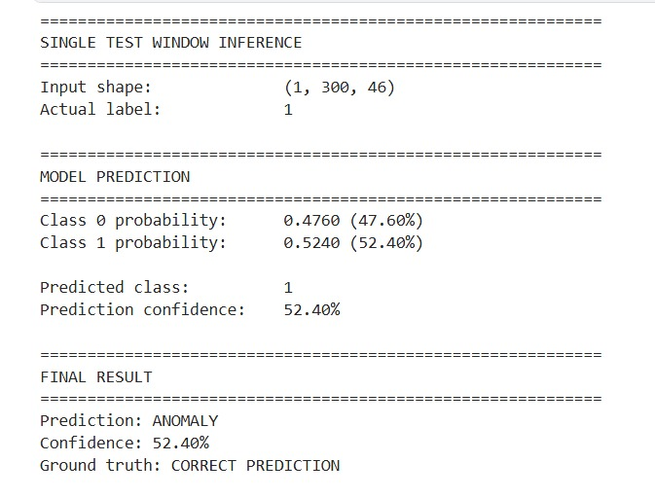
AERIS: NGAFID Branch
Single Input Demonstration
Unseen test window
Input Shape: 1 × 300 × 46
Actual: Fault
Model output
P(Normal) = 47.60%
P(Fault) = 52.40%
Prediction = Fault
Confidence = 52.40%
Correct prediction
This demonstrates that the trained model can perform inference and return class probabilities. The relatively low confidence also shows why further improvement is needed.

Slide 52
AERIS: NGAFID Branch
Remaining Work
Complete NGAFID Transformer Baseline
Evaluate model on independent test set
Single-window inference & prediction confidence
SHAP-based model explainability
– Identify important sensor features
– Explain individual predictions
Evidence extraction
– Extract predictive evidence from the Transformer
Dempster–Shafer evidence fusion
– Combine model evidence
– Generate final fault/normal decision

Slide 53
S.A. ENGINEERING COLLEGE- CHENNAI-77
(Autonomous- Institute Level Research Centre, Affiliated to Anna University)
DEPARTMENT OF ARTIFICIAL INTELLIGENCE & DATA SCIENCE
AD1703A - Project Phase-1
THIRD REVIEW
TITLE : AERIS
An Explainable Reasoning and Investigation System for Intelligent Aerospace Maintenance
BATCH NUMBER : 13
TEAM MEMBERS | SUPERVISOR
111923AI01003 – ABIRAMI M 111923AI01022 – DEVISHRI S | Mrs. NATHIYA M, Assistant Professor, Department of AI&DS

Slide 54
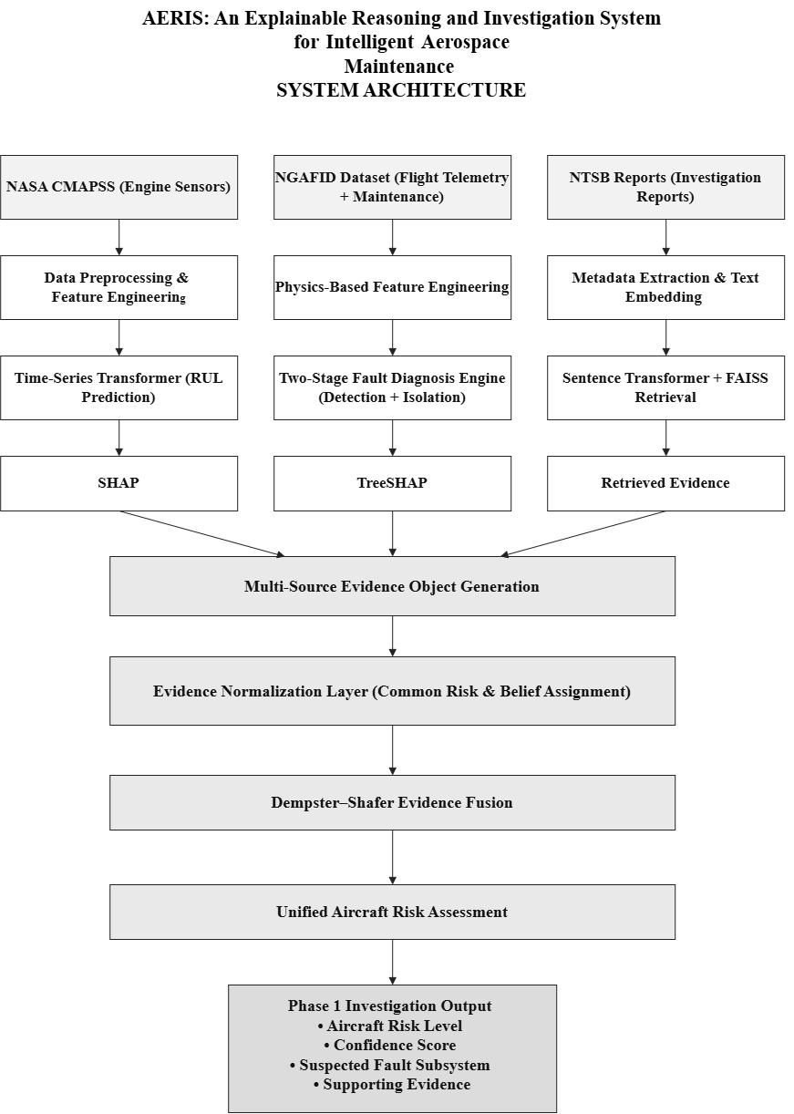

Slide 55
AERIS: CMAPSS Branch
SHAP Explainability
Transformer Output
Predicted RUL: 70.43 cycles
Problem:
RUL prediction alone does not explain which sensor patterns influenced the result.
SHAP:
Applied SHAP to the Transformer prediction
Calculates each feature's contribution
Identifies the most influential sensor features
Major contributing features:
Ps30 — Compressor outlet pressure
NRf — Fan speed
phi — Fuel-air ratio
T50 — Turbine temperature
P30 — Compressor pressure
Flow:
Transformer → RUL Prediction → SHAP → Feature Contributions

Slide 56
AERIS: CMAPSS Branch
From SHAP Features to Engineering Evidence
SHAP produces mathematical feature contributions.
AERIS further interprets these features in an engineering context.
Three-Level Interpretation
Level | Output
Model Level | SHAP contribution of each sensor
Feature Level | Pressure, temperature and rotational behaviour
Engineering Level | Probable affected subsystem
Reasoning Process
SHAP Ranking
↓
Dominant Sensor Features
↓
Engineering Significance
↓
Subsystem Association
↓
Probable Degradation Source
Example
Dominant features such as:
Ps30 + P30 + T50 + NRf
indicate important changes in compressor / engine-flow behaviour.
Probable Subsystem
High-Pressure Compressor
Why this matters
The system moves beyond:
“RUL = 70.43 cycles”
to:
“The predicted degradation is primarily associated with sensor behaviour related to the High-Pressure Compressor.”

Slide 57
AERIS: CMAPSS Branch
How SHAP Becomes Evidence in AERIS
CMAPSS → AERIS Evidence Pipeline
CMAPSS Telemetry
↓
Time-Series Transformer
↓
Predicted RUL
(Example: 70.43 cycles)
↓
SHAP Analysis
↓
Top Contributing Sensors
↓
Engineering Interpretation
↓
Probable Subsystem
(High-Pressure Compressor)
↓
Semantic Query
"Compressor Pressure Degradation Failure"
↓
NTSB Semantic Retrieval

Slide 58
AERIS: CMAPSS Branch
What SHAP Contributes to AERIS
Explainability
Identifies why the CMAPSS model produced its RUL prediction.
Engineering Evidence
Links influential sensor behaviour to a probable subsystem.
Investigation Trigger
Converts the identified degradation pattern into a semantic investigation query.
Multi-Source Reasoning
The resulting evidence can be combined with:
NGAFID → Operational evidence
NTSB → Historical evidence
CMAPSS → Predictive + engineering evidence
Core AERIS Contribution
SHAP acts as the bridge between a numerical ML prediction and the engineering evidence required for multi-source aircraft investigation.

Slide 59
AERIS: NGAFID Branch
Why the Raw Transformer Failed
Limitations of Deep Sequence Modeling on Real-World Flight Telemetry
Initial Experiment
Raw NGAFID telemetry → 300 × 46 Transformer input
Test ROC-AUC: 0.604
Test F1-Score: 0.473
Key Challenges
Flight-duration heterogeneity: Fixed padding/truncation distorted temporal patterns.
Non-stationary flight regimes: Climb, cruise, descent, pilot inputs and turbulence created strong non-fault variation.
Limited physical guidance: The model had to learn relationships such as EGT/CHT imbalance and oil behaviour directly from raw data.
Limited interpretability: Attention-based predictions did not directly provide maintenance-oriented evidence.
Key takeaway: Raw sequence modeling was insufficient for reliable diagnosis on noisy, heterogeneous general-aviation telemetry.

Slide 60
AERIS: NGAFID Branch
Our Approach: Physics-Informed Hierarchical Diagnosis
NGAFID Pipeline
Raw Telemetry
↓
5 Flight-Phase Segmentation
↓
Physics-Based Feature Engineering
↓
437 Structured Features
↓
Two-Stage LightGBM
↓
Fault Probability → Subsystem Ranking
↓
TreeSHAP Evidence
Stage 1 — Anomaly Screening
Binary classification
Detects pre-maintenance degradation
Operating threshold: τ = 0.62
Stage 2 — Subsystem Isolation
Activated when Stage 1 flags an anomaly
Ranks 7 physical subsystems
Why LightGBM?
Efficient on structured/tabular data
Robust to noisy telemetry
Fast inference
Compatible with feature-level explanations

Slide 61
AERIS: NGAFID Branch
Data & Physics-Informed Feature Engineering
Dataset
28,935 real-world flights
Approximately 1 Hz telemetry
23 primary sensor channels
Leakage-Safe Labeling
Positive: Flights 24–48 h before unscheduled maintenance
Maintenance day: Excluded
Negative: Flights with no maintenance write-up within surrounding ±30 days
5 Operational Phases
Takeoff / Initial Climb
En-Route Climb
Cruise
Descent
Final Approach
Feature Engineering
Statistical measures
Temporal trend/slopes
Sensor variability
EGT/CHT differentials
Oil pressure–temperature relationships
23 sensors × phase-based metrics → 437 engineered features

Slide 62
AERIS: NGAFID Branch
RESULTS
Stage 1 — Fault Screening
Metric | Result
ROC-AUC | 0.7019
Active-Failure Recall | 77.72%
Events Flagged | 844 / 1,086
Healthy-Flight Specificity | 98.09%
Accuracy | 75.30%
Stage 2 — Subsystem Isolation
Metric | Result
Top-1 Accuracy | 44.29%
Top-2 Coverage | 66.11%
Top-3 Coverage | 82.04%
Zero-Recall Classes | 0 / 7

Slide 63
AERIS: NGAFID Branch
Real-Flight Validation & NGAFID Contribution
Flight #31141 Case Study
Stage 1
Fault probability: 61.4%
TreeSHAP Evidence
E1_OilP_seg5_std → φ = +0.2718
E1_OilP_seg3_mean → φ = +0.1459
Stage 2
Top candidate: Rocker / Valvetrain
Confidence: 41.5%
Maintenance Verification
Unscheduled maintenance approximately 28 hours later
Maintenance record: rocker-cover gasket weeping + valvetrain oil leakage
Computational Footprint
14.2 ms inference / ~2-hour flight
1.8 MB model size
Single commodity CPU thread
NGAFID Contribution to AERIS
Real-flight telemetry → anomaly detection → subsystem candidates → explainable evidence → maintenance investigation

Slide 64
AERIS: NGAFID Branch
TreeSHAP reveals which engineered telemetry patterns drive the diagnosis.
437 Engineered Features
→ Phase-wise statistics
→ Trends & variability
→ Sensor relationships
→ Physics-informed indicators
TreeSHAP Analysis
437 Features
↓
Feature Contribution
↓
Positive / Negative SHAP Values
↓
Most Influential Features
↓
Physical Interpretation
Example — Flight #31141
SHAP Feature | Contribution | Interpretation
E1_OilP_seg5_std | +0.2718 | Oil-pressure variability
E1_OilP_seg3_mean | +0.1459 | Oil-pressure behaviour
What this provides
Identifies the specific telemetry patterns behind a fault flag.
Shows whether each feature supports or opposes the prediction.
Provides interpretable evidence for subsystem isolation and downstream fusion.
AERIS Role:
Raw Telemetry → Engineered Features → TreeSHAP Evidence → Subsystem Diagnosis

Slide 65
AERIS: NTSB Branch
NTSB Investigation Data Preparation
NTSB — Converting Investigation Reports into Searchable Evidence
Objective:
Use historical aviation investigations to provide case-based evidence for the fault identified by the predictive models.
Processing Pipeline
NTSB Investigation Reports
↓
Metadata & Text Extraction
↓
Structured Investigation Records
↓
Searchable Evidence Corpus
Role in AERIS:
Transforms unstructured investigation reports into a structured historical evidence source
Extracted Information
Event ID & aircraft information
Flight phase & environmental conditions
Damage / findings
Probable cause
Investigation report text
Output:
NTSB_metadata.csv

Slide 66
AERIS: NTSB Branch
NTSB — From Text to Semantic Vectors
Problem:
Keyword search may miss investigations that describe a similar failure using different terminology.
Approach:
SentenceTransformer — all-MiniLM-L6-v2
Converts each investigation report into a 384-dimensional semantic embedding.
Similar meanings are represented by nearby vectors.
Investigation Report
↓
SentenceTransformer
↓
384-Dimensional Embedding
↓
NTSB Embedding Matrix
Generated Artifact
NTSB_embeddings.npy
Key Idea:
The system searches for semantic similarity, rather than exact keyword matches.

Slide 67
AERIS: NTSB Branch
FAISS-Based Historical Case Retrieval
NTSB — Semantic Investigation Retrieval
Retrieval Flow
CMAPSS Engineering Evidence
↓
Semantic Query
"compressor pressure degradation failure"
↓
Query Embedding
↓
FAISS Similarity Search
↓
Top-K NTSB Investigations
↓
Similarity Scores
Example Retrieval
Query → Compressor pressure degradation failure
Top Match:
ENG19IA013
Similarity = 0.5698
Why FAISS?
Efficient vector similarity search
Scalable to large investigation collections
Returns ranked candidate cases
Enables case-based reasoning within AERIS
Output:
Relevant historical investigations + similarity scores.

Slide 68
AERIS: NTSB Branch
NTSB Evidence for AERIS Fusion
NTSB — From Historical Case to Investigation Evidence
The retrieved investigation is converted into a structured NTSB Evidence Object
Retrieved Investigation
↓
Probable Cause + Findings
↓
Similarity Assessment
↓
NTSB Evidence Object
↓
Fusion Evidence
Key Takeaway:
NTSB provides historical investigation context that helps connect a predicted degradation pattern with previously documented aviation events.
Evidence Contains
Retrieved investigation
Similarity score
Probable cause
Relevant findings
Supporting report
Hypothesis
Belief
Uncertainty
Example
Belief = 0.71
Uncertainty = 0.29
AERIS Contribution
Predictive Evidence (CMAPSS)
+ Historical Evidence (NTSB)
+ Operational Evidence (NGAFID)
→ Dempster–Shafer Evidence Fusion

Slide 69
Dempster-Shafer Evidence Fusion
Combined CMAPSS + NTSB + NGAFID belief values using full multi-hypothesis Dempster's rule
Result table:
Final decision: Medium Risk, confidence 98.5%
Conflict value (K=0.54) correctly flagged that NGAFID's case describes a different aircraft — a known, documented limitation, not an error
SOURCE | HYPOTHESIS | BELIEF
CMAPSS | Medium Risk | 0.972
NTSB | Medium Risk | 0.71
NGAFID | High Risk | 0.542

Slide 70
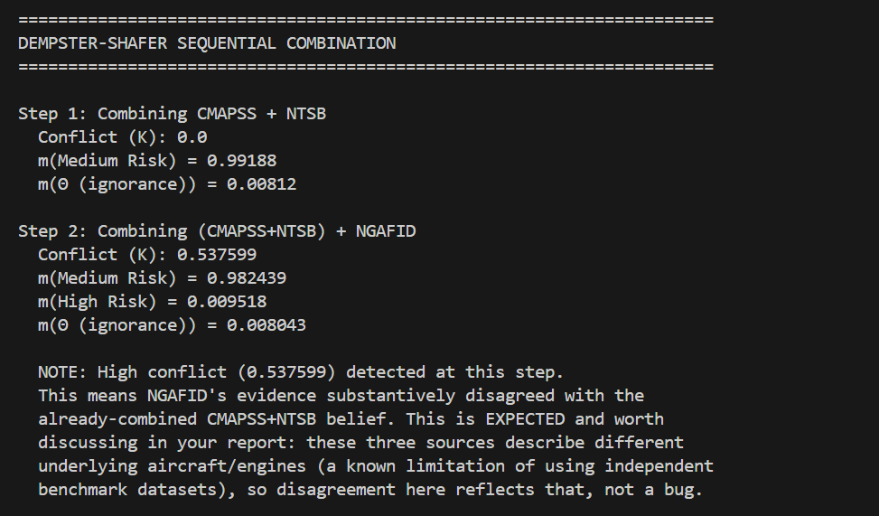
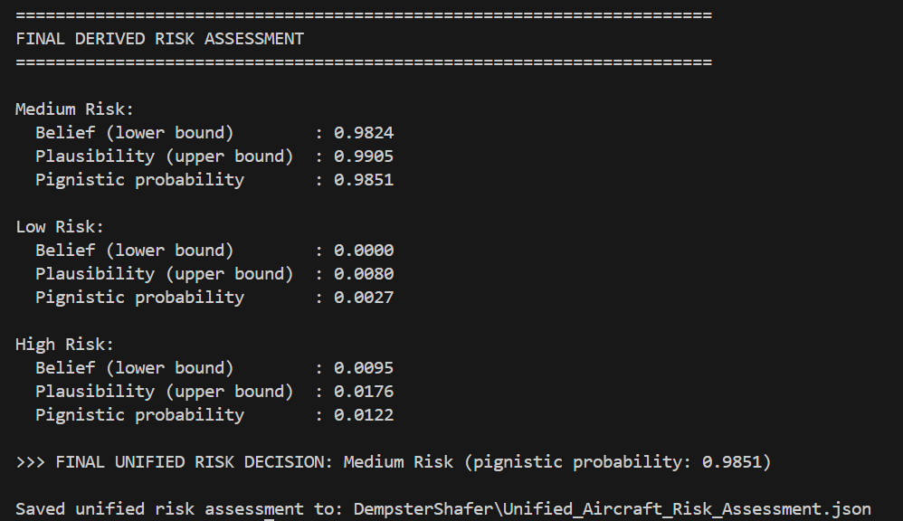
Dempster-Shafer Result

Slide 71
Final Explainable Investigation Output
"This is where all three data sources — CMAPSS, NTSB, and NGAFID — converge into one final, traceable answer.“
Aircraft Risk Level: Medium Risk (98.5% pignistic confidence)
Most Probable Fault Subsystem: High-Pressure Compressor (traced to CMAPSS, the highest-belief source)
Confidence range: Belief 97.2% — Plausibility 99.1% (explain: this is the lower and upper bound Dempster-Shafer guarantees, not a single point estimate — a key difference from a normal ML confidence score)

Slide 72
Final Explainable Investigation Output
The three supporting evidence panels (walk through each briefly):
CMAPSS (sensor evidence): Predicted RUL = 70.43 cycles, top contributing sensors via SHAP (Ps30, NRf, phi, T50, P30)
NTSB (historical precedent): Retrieved report ENG19IA013 — a real Boeing 737 HPC blade separation case, 57% semantic similarity to the generated query
NGAFID (independent flight evidence): Failure risk 61.4%, diagnosed subsystem "Rocker/Valvetrain" — flagged transparently as describing a different aircraft case in this Phase 1 prototype.
"The system doesn't just give a number — every value here is traceable back to a specific sensor, a specific historical report, or a specific flight record, which is the explainability goal from our original problem statement."

Slide 73
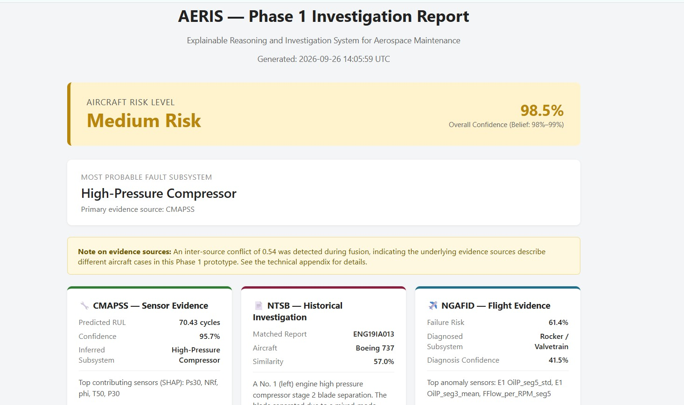
Final Report

Slide 74
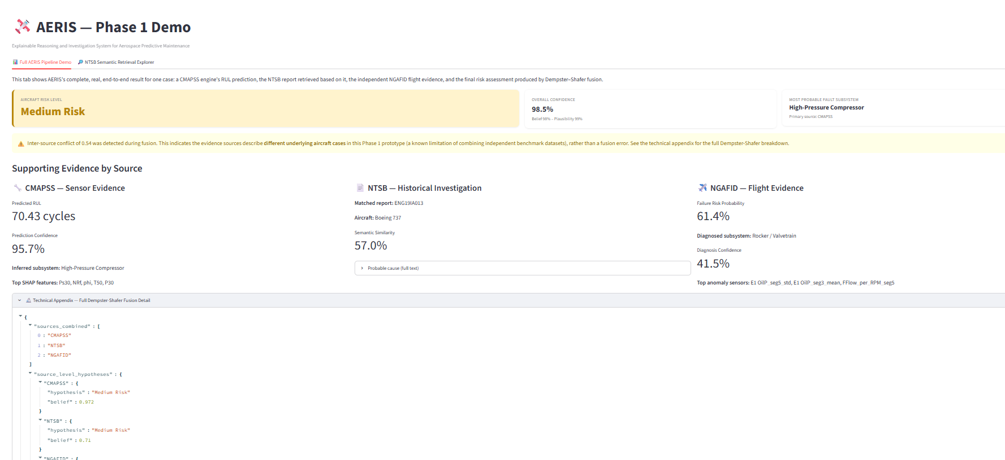
Final Report

Slide 75
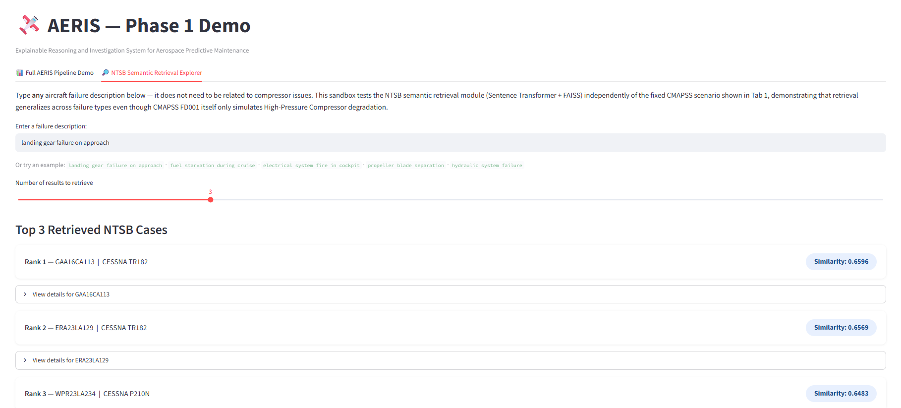
Final Report
The live query field — it embeds the query with the same Sentence Transformer and searches your real FAISS index, showing ranked results with similarity scores.

